Slide 1
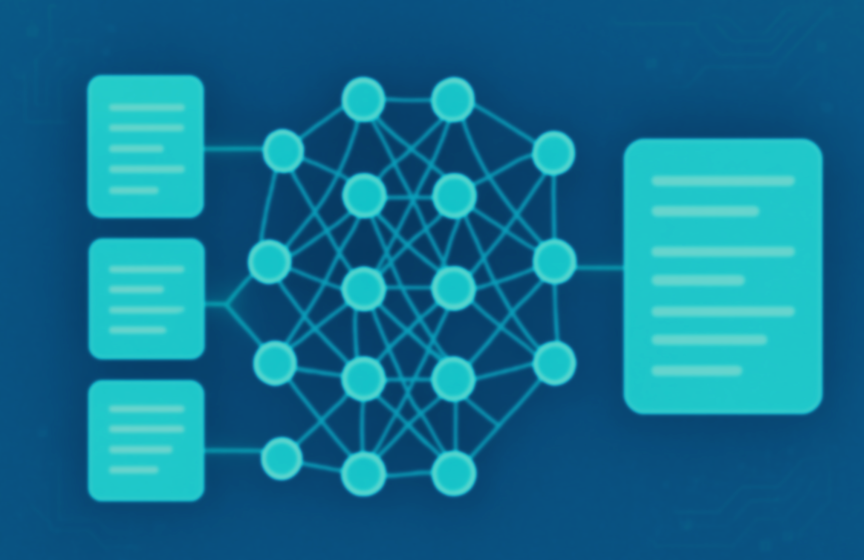

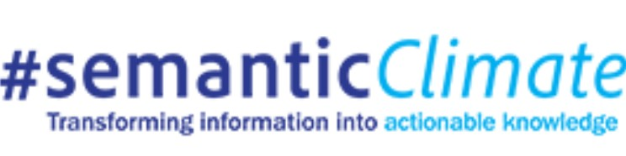

AI-Assisted Literature Review: Summarization using Transformer
Presenter: Shabnam Barbhuiya

Slide 2

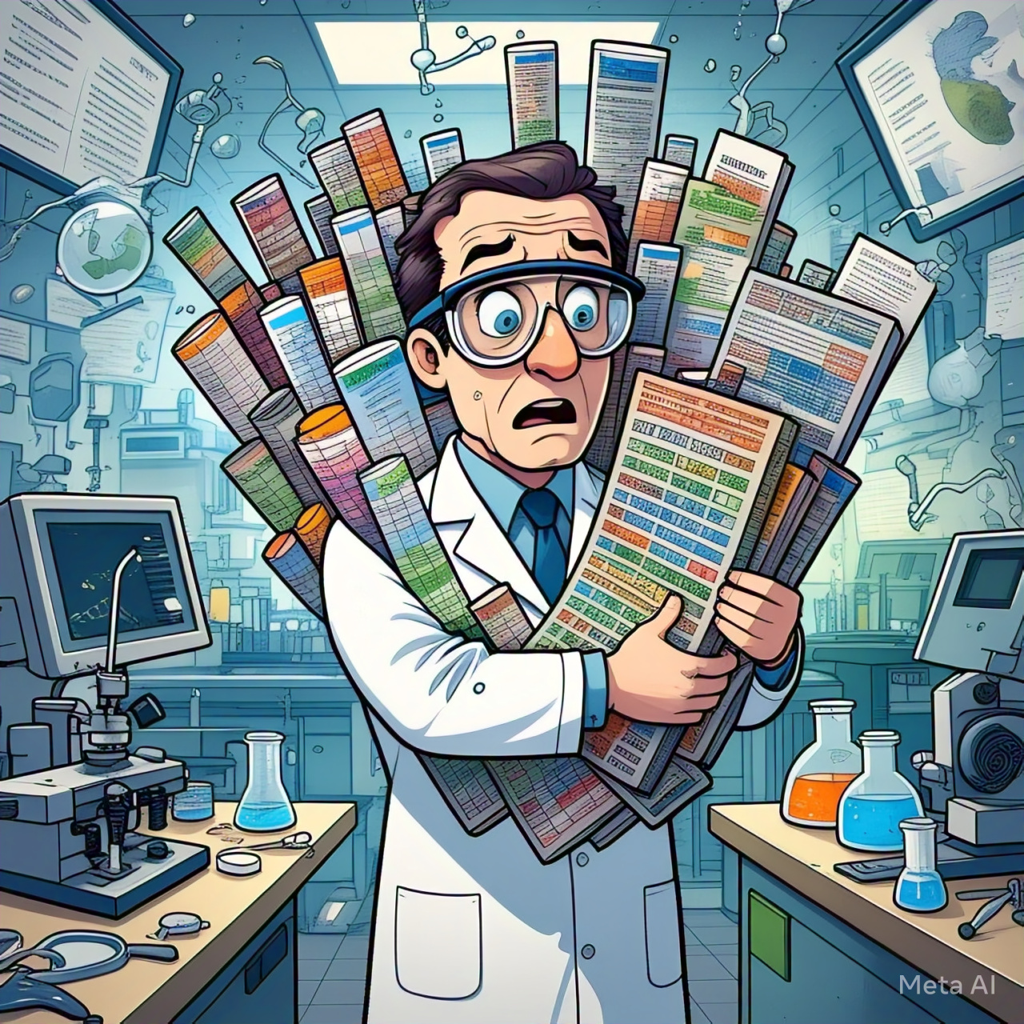
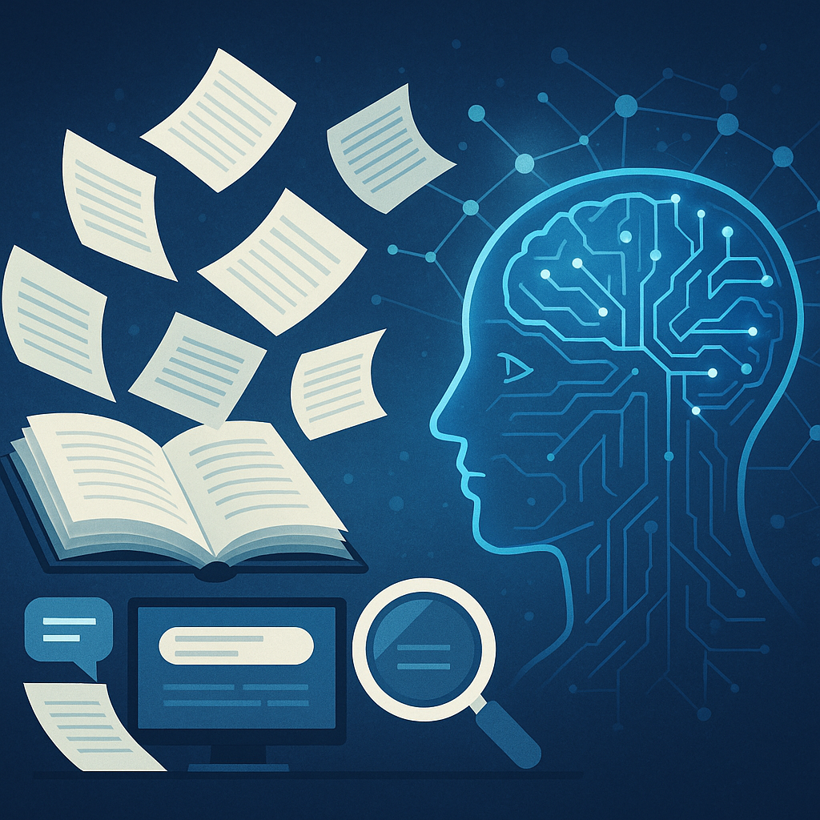
Seeing the Big Picture—Faster
Traditional Method
Current Landscape
Traditional literature reviews are time-consuming, manual, and prone to bias.
With the exponential growth of publications, it’s harder to stay updated.
AI and NLP technologies now enable faster, scalable, and context-aware analysis

Slide 3
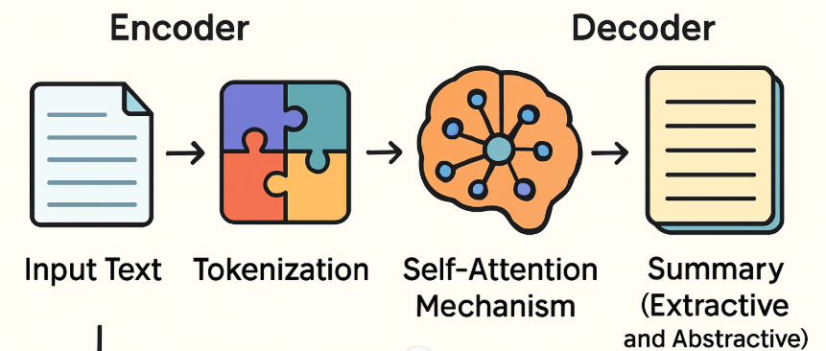
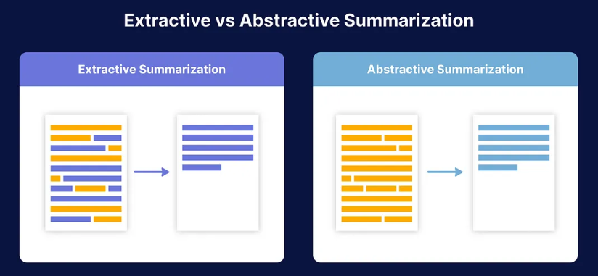
Transformers at Work: Breaking Down Summarization

Slide 4
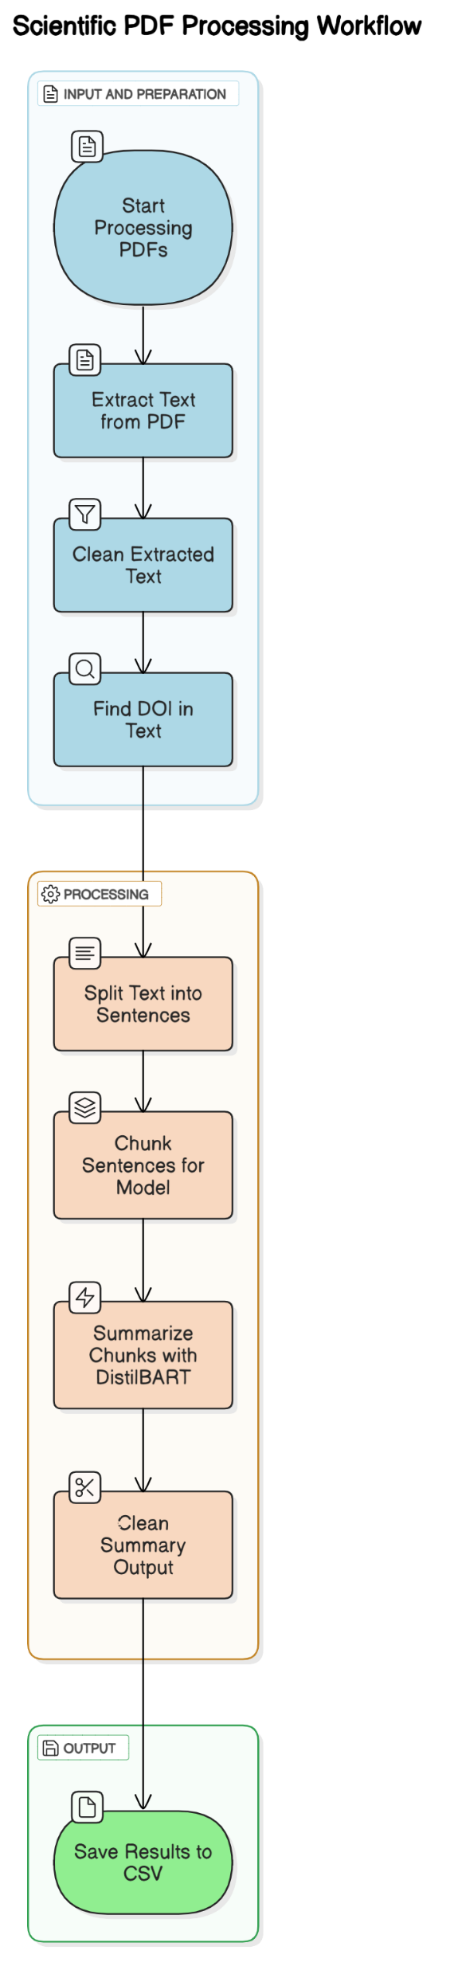
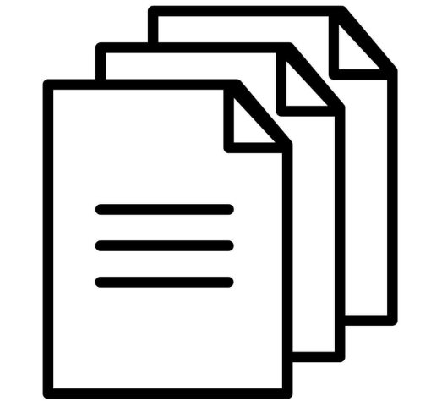
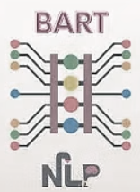
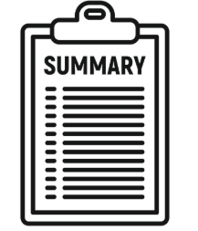
Summarization Workflow
Library Used:
PyMuPDF – Extracts clean text from PDFs
NLTK – For sentence tokenization
DistilBART (via HuggingFace) – Transformer model for summarization
Pandas – Store DOI + Summary as CSV

Slide 5

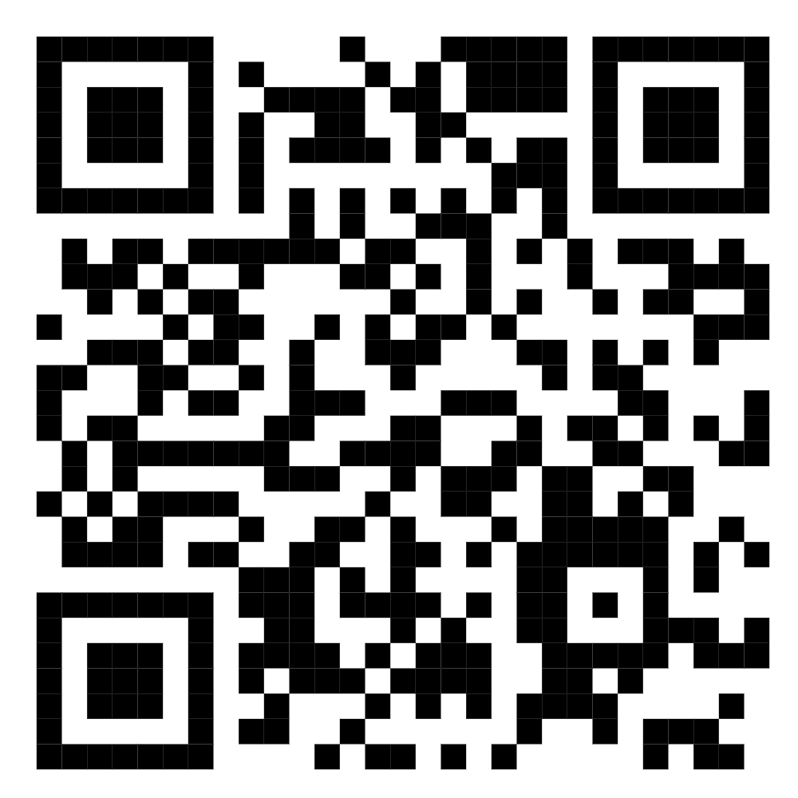

Slide 6
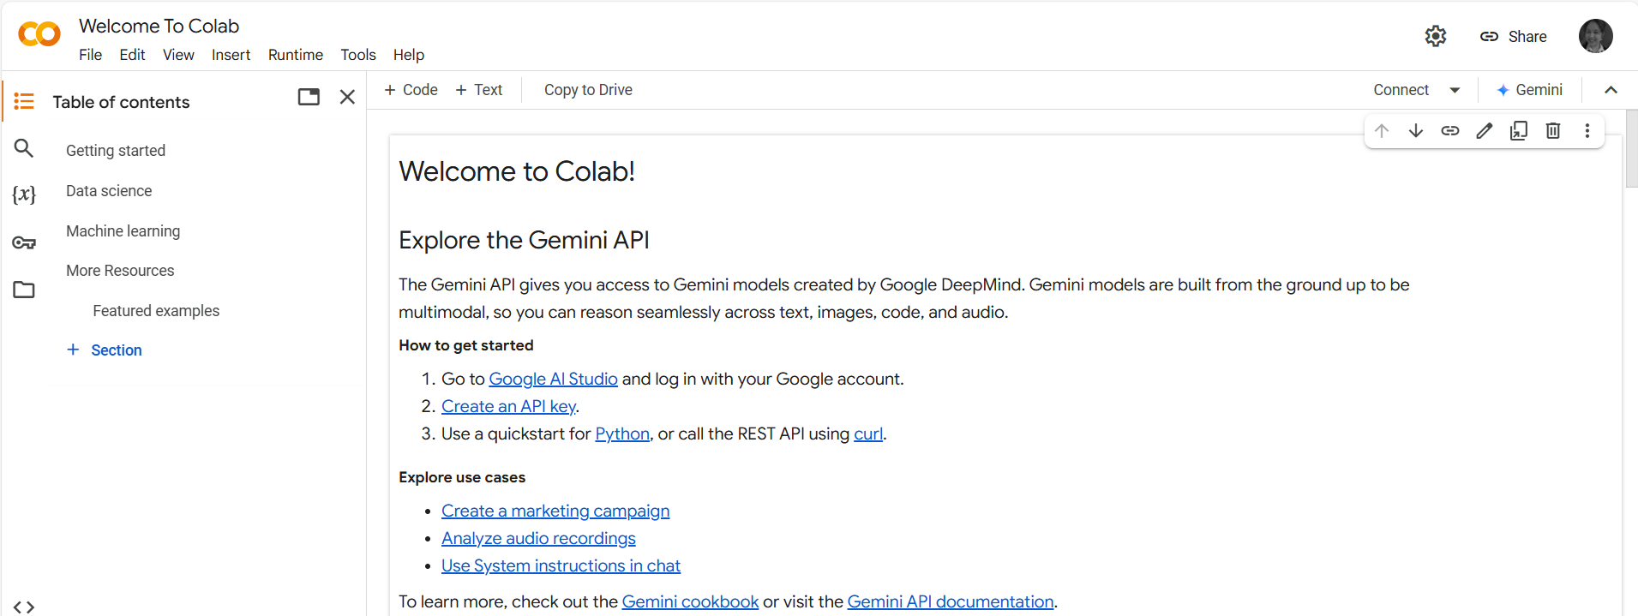
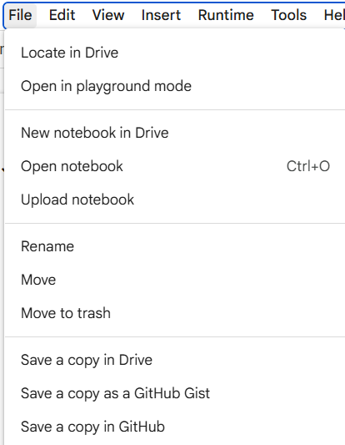
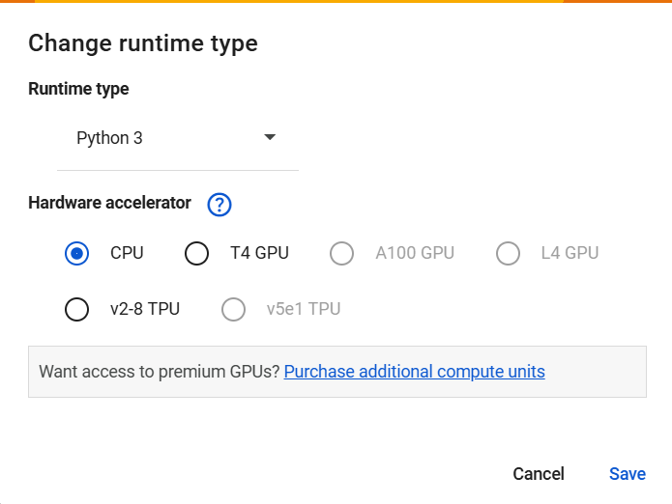
INSTRUCTION
Setting Up Your Colab Notebook
Home Page
1. Copy the Colab Notebook to Your Own Google Drive Go to the menu and click: File → Save a copy in Drive
2.Change the Runtime to GPU
In the Colab menu, select: Runtime → Change runtime type

Slide 7
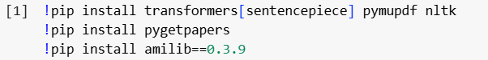
Step-by-Step Implementation in Colab
Step 1 – Install Required Libraries
Step 2 – Download Research Papers
Use ‘pygetpapers’ to search by topic/keyword and download PDFs.
Download fulltext PDFS
Save the passed query in a config file
Search Query

Slide 8
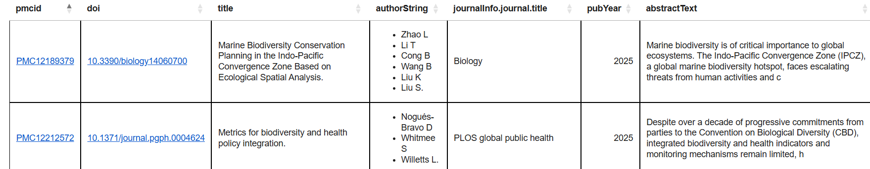
Step-by-Step Implementation in Colab
Step 3 – Create and Visualize Retrieved Article using ‘amilib’
OUTPUT

Slide 9
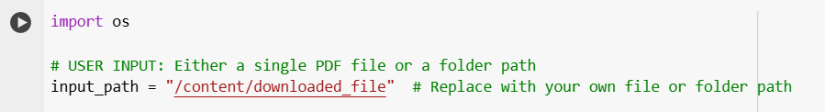
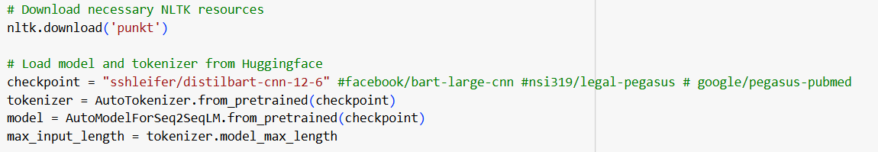
Step-by-Step Implementation in Colab
Step 4 – Load PDFs for Summarization
Step 5 – Initialize Model & Tokenizer
Default: ‘sshleifer/distilbart-cnn-12-6’ (Changeable)

Slide 10
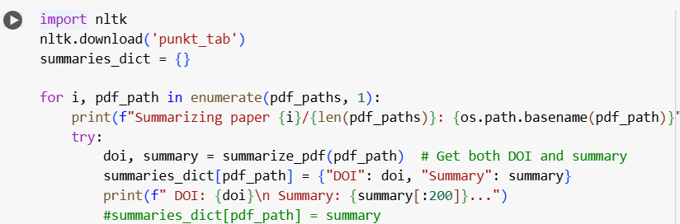
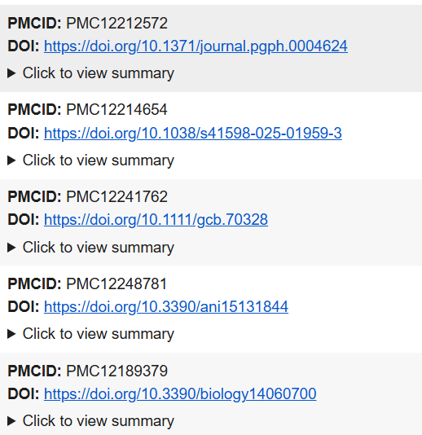
Step-by-Step Implementation in Colab
Step 6&7 – Summarize and Export
Output

Slide 11
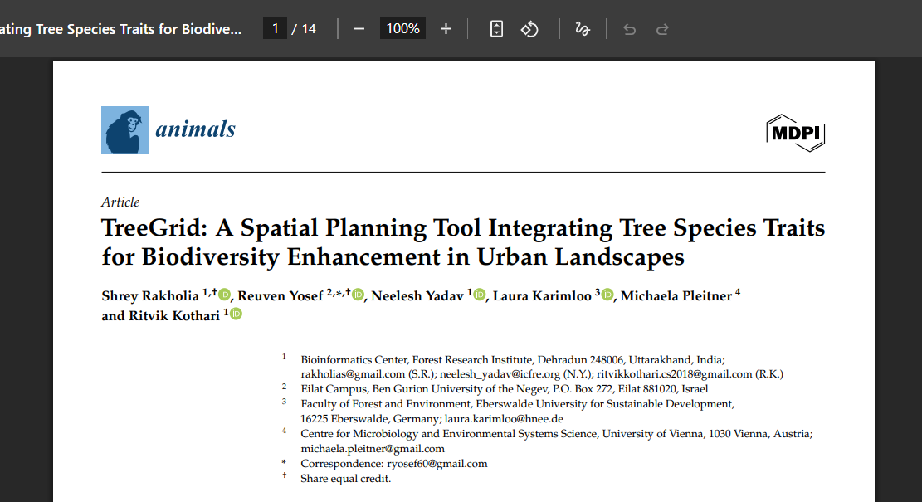
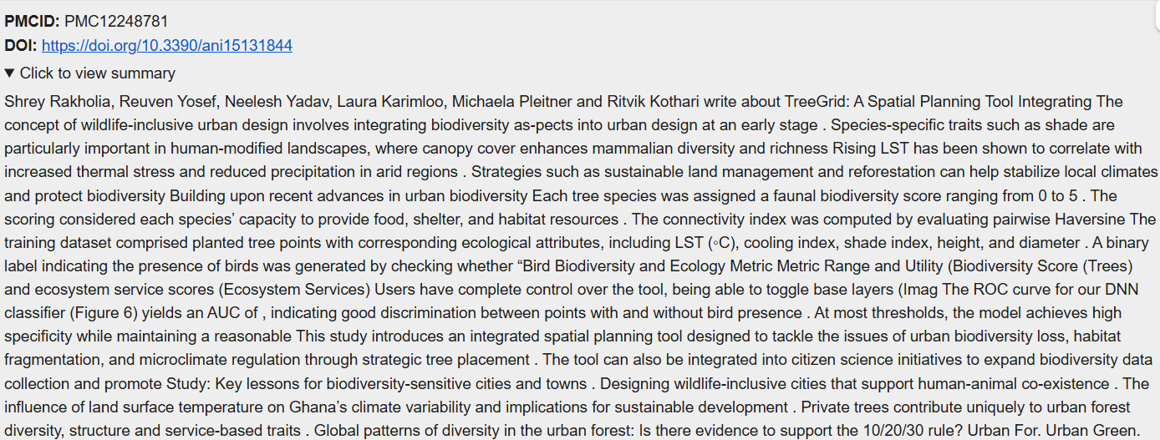
Output
Before: ORIGINAL PAPER
After: SUMMARY

Slide 12
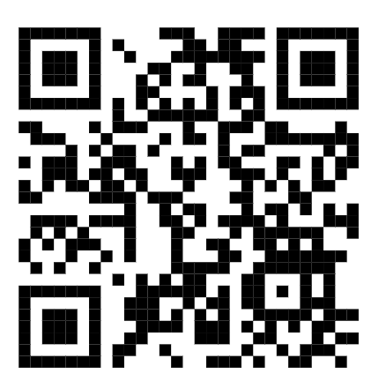
!!!!Try It Yourself!!!!
- Open the Colab link provided and make your own copy.
- Practice uploading, processing, and summarizing a research article.
- Experiment with different PDFs and see how the summaries vary.
COLAB LINK:
JOIN OUR DISCORD COMMUNITY:
https://colab.research.google.com/drive/1el5Zjogk7DXqqeuBzGMqFDBGTvyWg1Pm?usp=sharing -

Slide 13

THANK YOU

